Slide 1
CA PPM for Strategic Planning and Execution
Please print only when necessary to avoid needless waste of paper and toner.
Strategic Execution Support Alexandre Assis, PMP®
July 2015

Slide 2
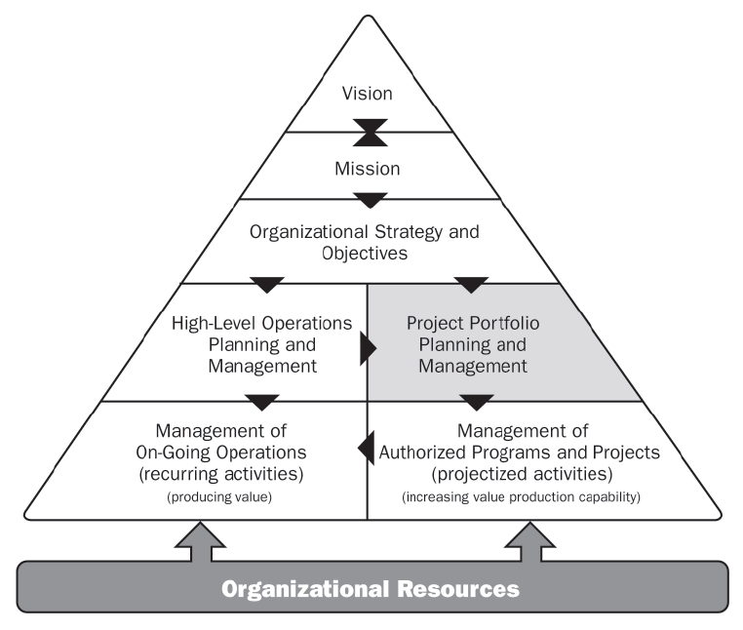
Expanding CA PPM capabilities
CA PPM PMO Accelerator Out-of-the-box capabilities
CA PPM configuration for Strategic Planning and Execution additional capabilities
Source: Project Management Institute, The Standard for Portfolio Management, second edition.
Notes:
CA PPM for Strategic Planning and Execution expands CA PPM Core Features towards Strategic Planning and Monitoring Business Results in relation to the Organization’s Strategies.

Slide 3
CA PPM for Strategic Planning and Execution
Overview of Strategic Planning and Execution Support with CA PPM
A Strategic Plan only makes sense when it is directly connected to a decision-making process on the necessary resources and investments that will make it possible for actual Results to be delivered through an effective and efficient Execution.
To address this constant feedback cycle between Planning and Execution we created the “CA PPM for Strategic Planning and Execution” accelerator.
CA PPM, being flexible and configurable, allows us to reflect your Strategic Planning processes in the solution, and therefore, directly connecting it to the Portfolio, Investment and Resource Management capabilities. This way, we can assess them in light of the strategic goals, initiatives and indicators defined by your organization.
Notes:
This is the RATIONALE for this Accelerator.
There is nothing new about Strategic Planning, right? All organizations, big or small, have implemented some sort of strategic planning method these days, obviously with different maturity levels, granularity, precision; some are at department level, some at business unit level, some at corporate level, or even all of the above...
Many of our PPM customers need a way to “do the right things”- that is – selecting the best investments on which apply your financial and human resources in order to achieve optimal results. However, one of the most challenging aspect our customers are finding is: how can I connect both worlds Strategic Planning and Project Execution?
Are the things I’m doing THE best to achieve the results I proposed to achieve with my Strategic Plan?
Is the way our projects are being delivered generating any impact – positive or negative – on the results?
Do I need to correct anything on our Execution?
How much of my Goals have I already reached – and what is the forecast – When will I be able to see the final results of the Strategies?

Slide 4
CA PPM for Strategic Planning and Execution
Implementing a Continuous Strategic Planning process
The Strategic Plan drives the Investment Budget and defines metrics for later use in the selection of Investments to be executed.
The Investment Budget originates the Portfolios, applying the selection and prioritization criteria to define programs and projects to be executed – given the execution capacity (financial and human resources).
Execution is monitored because the progress of programs and projects indicates the trend of success in the achievement of goals; this allows the rapid correction of direction when necessary.
Indicators feed the strategic plan with measurements to be compared to the established targets for verification of actual results.
Strategic Plan
Bottom-Up Indicators
Top-Down Budget
Execution
Initiatives Portfolio
Program and Project Selection
Actual
Results
Overall Investment
Health-Check
Selection Metrics
Measurements
Continuous Strategic Planning
Execution Capacity (CAPEX and Headcount)
Resource Usage
Constraints and Criteria-based Selection with Objective Metrics
Notes:
Our suggestion is to implement a “Continuous Strategic Planning and Execution” process. The Strategic Plan brings multiple levels of strategic goals to our organization. It also defines the metrics that allow us to score our investments against those goals. From the Strategic Plan we start distributing funds and headcount through a Top-Down Planning process. The Top-Down budget will fund and source Strategic Initiative Portfolios. In the Portfolios we will be able to balance our strategic-driven Portfolio Targets (Headcount and CAPEX) and our Strategic demand – by using our investment strategic alignment score and other investment criteria such as risk and ROI fro Prioritizing and Selecting the best Investments to deliver on our strategy, resulting in a Portfolio of Prioritized Programs and Projects that were selected to maximize our strategic results. That is what we call Strategic Execution – the ability to link the Top-Down Strategic Planning Decision-Making process directly to the Tactical level Portfolio Decisions and Operational level Initiatives, Investments and Project Execution. At the same time, the detailed execution of these programs and projects needs to be constantly monitored – because they will serve as a strategy “health-check”. We say that because the programs and projects are the means to delivering on our results. If I have X projects supporting a specific Strategic Goal – and all of them are riddled with issues, are late, presenting high risk, over budget, have undefined scope – what does it mean to my strategy? Will I be able to achieve my expected results? At this moment, the strategic planner can step up, proactively, understanding the impacts they can serve as a facilitator, a second sponsor, a project success enabler, and therefore, a strategy enabler.
But how do I know we are getting results? Measuring is the only way. Therefore, we define Indicators and we set Targets and perform periodic Measurements for those indictors; In time, we will be analyzing the delivery trend – in time to correct deviations if/when necessary.

Slide 5
CA PPM for Strategic Planning and Execution
Overview of Strategic Planning and Execution Support with CA PPM
In the next slides, we present you some illustrations taken from CA PPM, which was configured to provide specific features for planning and monitoring of the Strategic Execution.
Note: the features you will see are not an integral part of the "Core" features of CA PPM but can be implemented through configured and customized components. Adjustments to adherence to the actual process of the organization are encouraged through the hiring of specialized services with CA Services or with one of our Qualified Partners.
Notes:
Now you are going to see an idea of some features that could be implemented to expand the PPM “core” features and allow the Strategic Planning and Monitoring process to walk alongside the PPM processes. These features are not an integral part of CA PPM but can be implemented with very little effort by our CA Services and our CA Qualified Partners teams.

Slide 6
CA PPM for Strategic Planning and Execution
The complete cycle in four big groups
2 Strategic Review
3 Investment Evaluation
1 Strategic Maps
4 Top-Down Planning
Notes:
For easy-of-use and implementation we are presenting the new features in four big groups, and we present them in the order they would usually be implemented:
Strategic Maps with Items and related Indicators
Strategic Review and Monitoring
Investment Evaluation for Selection and Prioritization
Top-Down Planning to distribute Funds and Headcount

Slide 7
CA PPM for Strategic Planning and Execution
2- Revisão
De Estratégias
3- Avaliação de Investimentos
1- Mapas Estratégicos
4- Planejamento Top-Down
Group 1: Creating the Strategic Map and the Indicators Hierarchy
Features
Multi-level Strategic Items (Themes, Goals, Objectives, Initiatives, etc) related to the Strategic Perspectives;
Indicators to monitor the results of strategies;
Graphical View of the Strategic Map and the Indicator Hierarchy.
Implementation Assumptions
A Strategic Plan has been created and it contains the Objectives (or whatever you call them).
Indicators are identified – and you know how they influence each other and how they influence your Strategic Goals

Slide 8
CA PPM for Strategic Planning and Execution
2- Revisão
De Estratégias
3- Avaliação de Investimentos
1- Mapas Estratégicos
4- Planejamento Top-Down
Group 2: Strategic Review
Features
Strategic Item Status and Indicators Monitoring
Graphical View of the Strategic Map and the Indicator Hierarchy with Status
Projects Impacting the Strategies (Health-Check)
Strategic Results Delivery Roadmap.
Implementation Assumptions
There are Investments that support your Strategies being managed in CA PPM.
The standard CA PPM Project Health-Check KPIs* are in use
There is a process to set Targets and performing Measurements for each Indicator * (Days Late, Schedule %, Cost %, Effort %, Issues, Risk Score, Changes)

Slide 9
CA PPM for Strategic Planning and Execution
2- Revisão
De Estratégias
3- Avaliação de Investimentos
1- Mapas Estratégicos
4- Planejamento Top-Down
Group 3: Investment Evaluation for Selection
Features
Metrics to evaluate Investments in light of the Strategies in an objective way;
Normalized scale to minimize subjectivity in the evaluation process;
The Evaluation Cycle generates the Investment “Score” in light of Metrics;
The “Score” feeds the Portfolios for investments selection and prioritization.
Implementation Assumptions
There is a periodic Evaluation process of the business value generated by investments
The strategic investments have “Business Cases” with established metrics
The metrics used in the “Business Cases” are related to the Strategic Goals

Slide 10
CA PPM for Strategic Planning and Execution
2- Revisão
De Estratégias
3- Avaliação de Investimentos
1- Mapas Estratégicos
4- Planejamento Top-Down
Group 4: Top-Down Planning
Features
Top-Down distribution of Expected Benefits, FTEs and Funding
Roll-up of amounts Allocated to Strategic Items and Committed with Investments
Automatic Creation of Portfolios for Investment Selection and Monitoring
Implementation Assumptions
A Strategic Planning Budgeting process that established high-level amounts to be distributed
An allocation rule (or we can assume the Items weights are to be adopted)
A Portfolio group (and the Strategic Items to which they are related)
Definition of the Item (Strategic Goal) that funds each Strategic Investment.

Slide 11
CA PPM for Strategic Planning and Execution
The complete cycle in four big groups
2 Strategic Review
3 Investment Evaluation
1 Strategic Maps
4 Top-Down Planning
End
Notes:
For easy-of-use and implementation we are presenting the new features in four big groups, and we present them in the order they would usuallybe implemented:
Strategic Maps with Items and related Indicators
Strategic Review and Monitoring
Investment Evaluation for Selection and Prioritization
Top-Down Planning to distribute Funds and Headcount

Slide 12
Creating the Strategic Map and Indicator Hierarchy

Slide 13
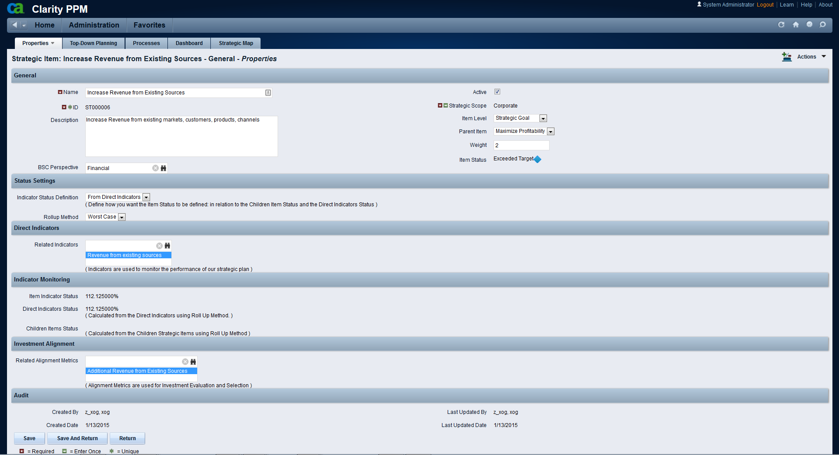
Creating the Strategic Map
This is an existing Strategic Item (a Strategic Goal)
Multi-Dimensional Evaluation: Corporate Strategy, BU Strategy, Department Strategy, etc.
Balanced Scorecard Perspective (Financial, Customer, etc.)
This Item’s Status
Configure how do you calculate Item Status
These are the Indicators directly related to this Strategic Item
Indicator Monitoring
% Goal Achieved from Direct Indicators AND from Children Items
Metrics used to evaluate Investment Strategic Alignment
(to evaluate the “Strategic Score” for Ideas, Projects, Programs, …)

Slide 14
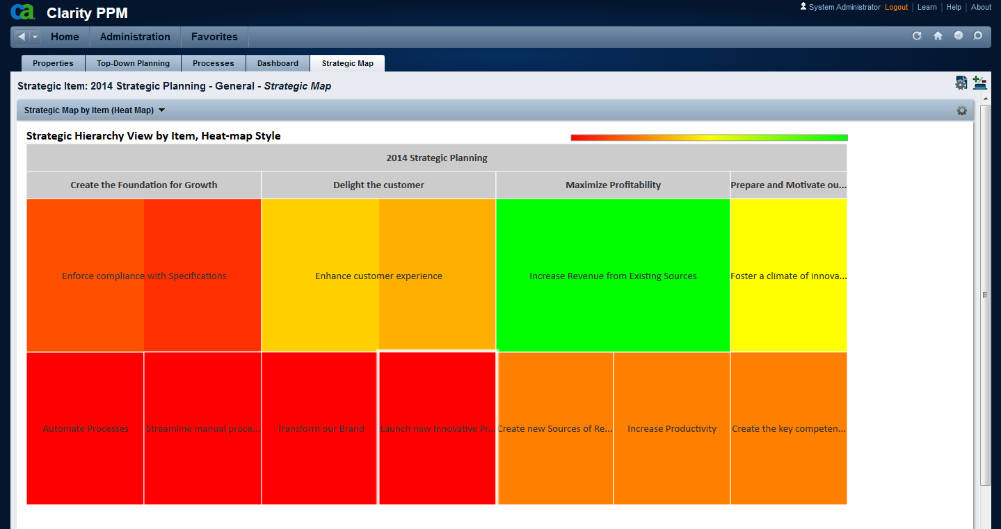
Creating the Strategic Map
Strategic Map

Slide 15
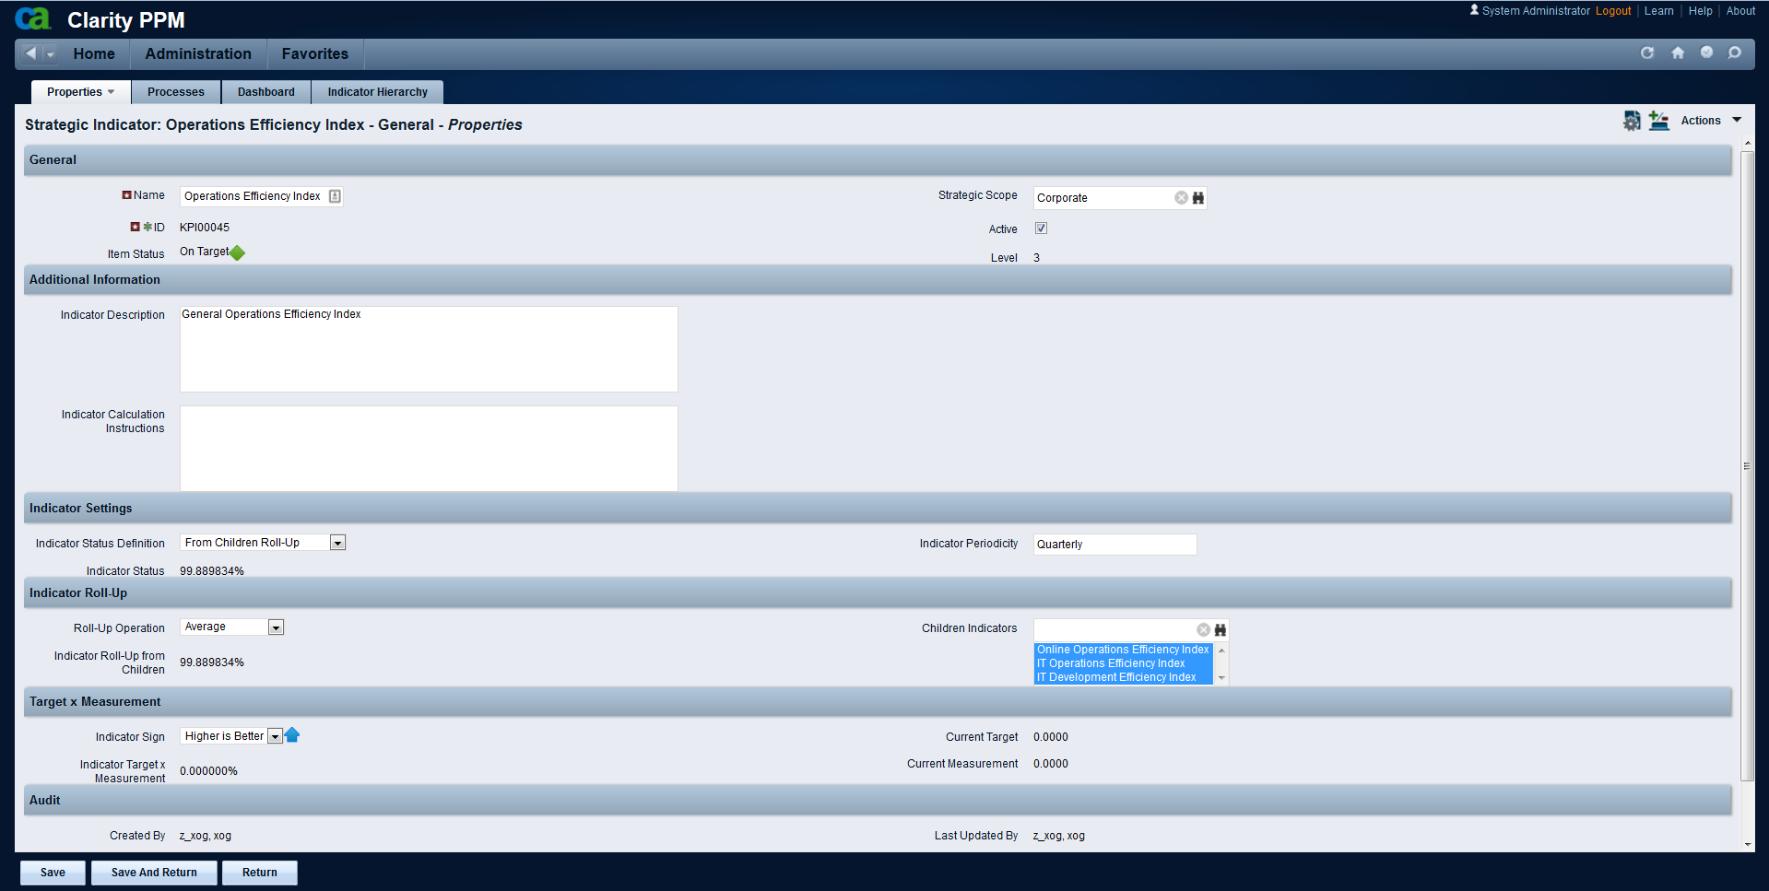
Creating the Indicator Hierarchy
This is the current Status for this indicator
Indicators are used to Monitor our Strategies; they help us know if our Strategic Goals are being delivered, through the comparison of “Targets”and “Measurements”
Configure the Indicator– defines how Status should be calculated
“Children” Indicators
Indirect Indicators (rolled-up from children Indicators statuses)
Comparison of Last Measurement against Current Target for this Indicator

Slide 16
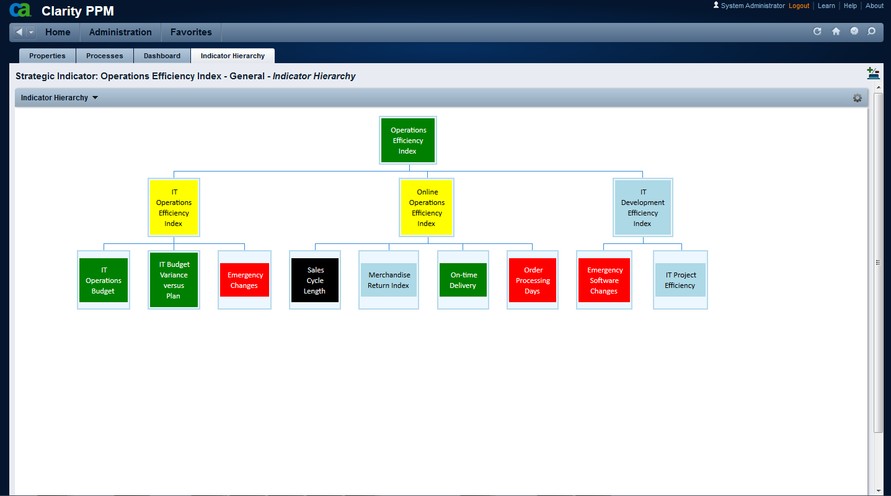
Creating the Indicator Hierarchy
Indicator Hierarchy
Go Back

Slide 17
Strategic Review and Monitoring

Slide 18
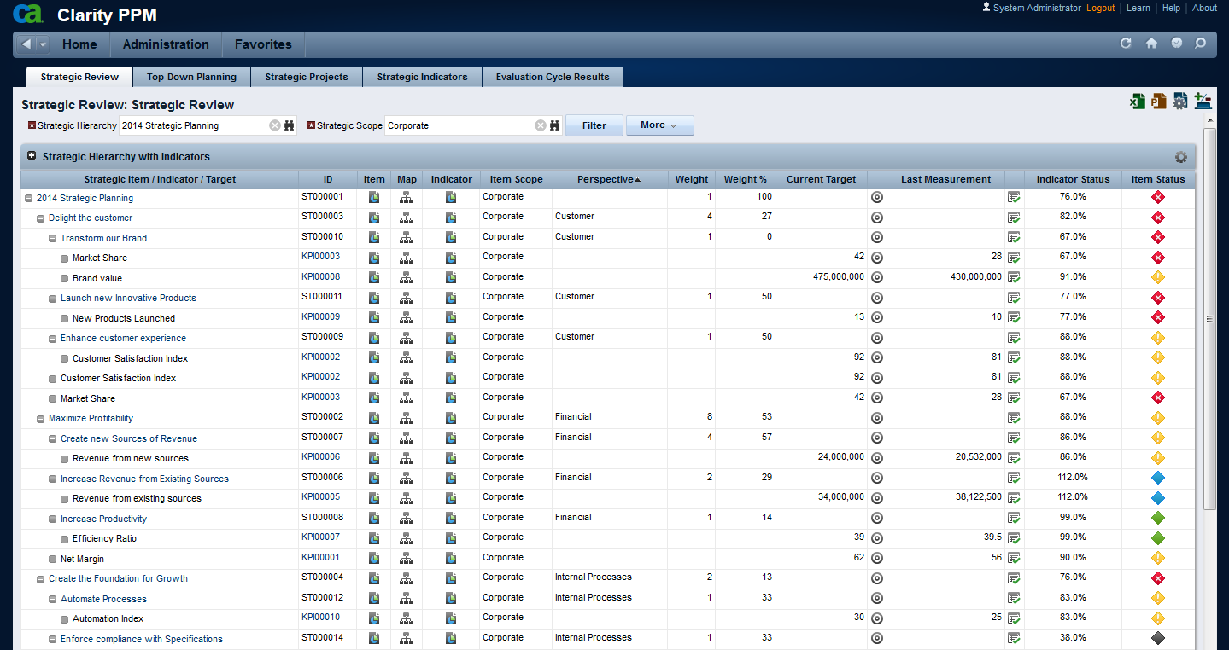
Strategic Items Review
Multi-Scope, Multi-Level Strategic Review with Indicators
Balanced Scorecard Alignment
Current Target and Last Measurement Drill-Down to Targets and Measurements over time
Strategic Hierarchy of Items with their Indicators
Rolled-up Item Status and Achieved Results

Slide 19
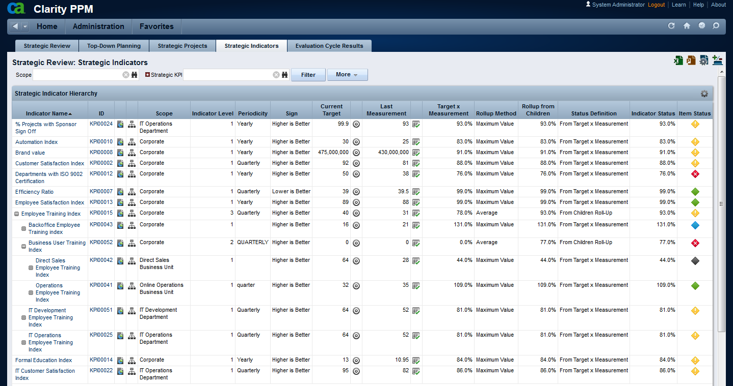
Strategic Indicators Review
Strategic Indicator Hierarchy
Indicator Hierarchy
Current Target and Last Measurement with
Drill-Down to Targets and Measurements over time
Rolled-up Item and Achieved Results

Slide 20
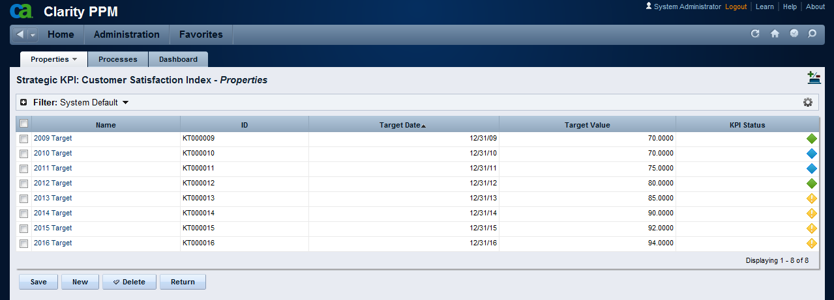
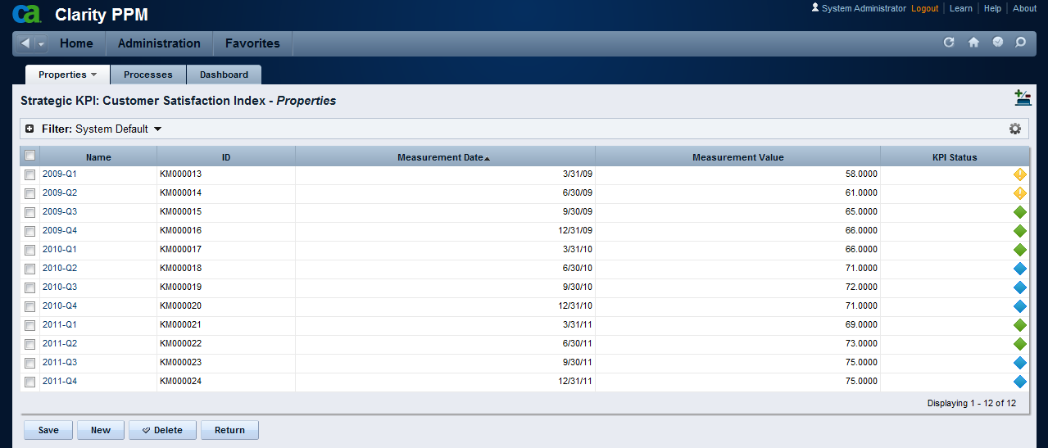
Strategic Indicators Review
These are the Targets set per Period
These are the periodic Measurements for this Indicator

Slide 21
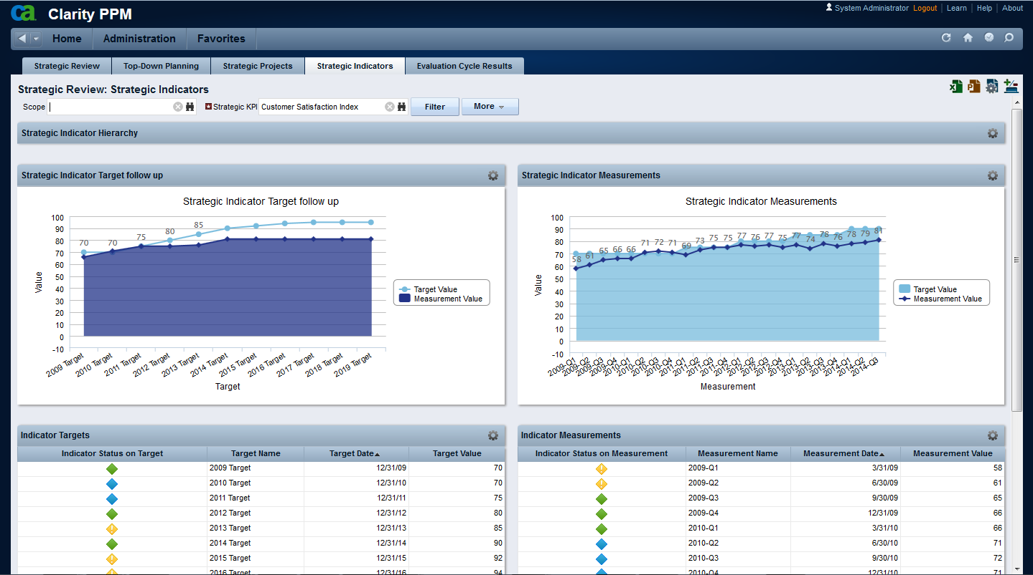
Strategic Indicator Trend
Target x Measurement at the end of each period
Measurement x Target on every measurement period

Slide 22
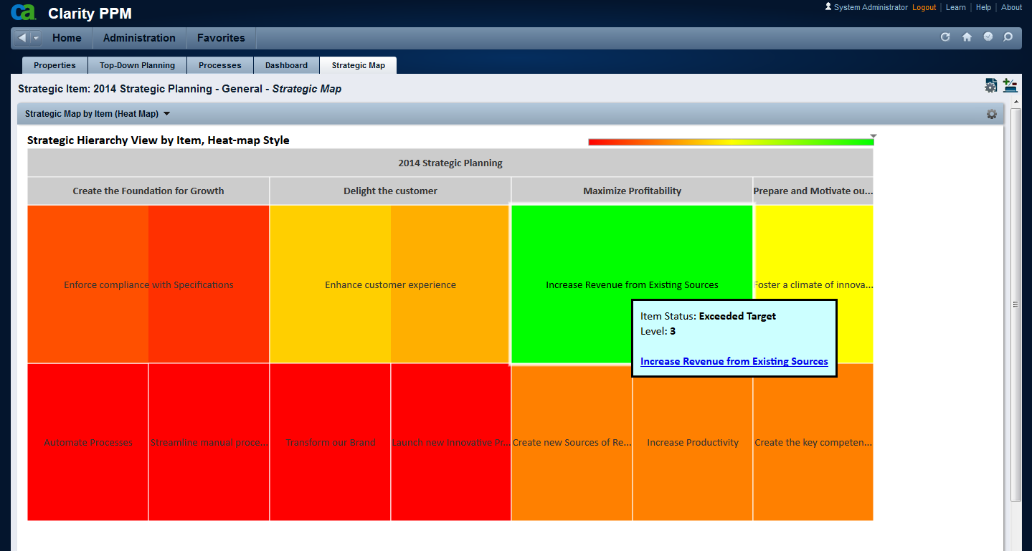
Graphical View of the Strategic Map
Strategic Map
Size represents Importance; Color represents % Achieved Results on the Color Scale
Click to Drill-Down
Additional Information with Direct Link

Slide 23
Graphical View of the Indicator Hierarchy
Indicator Hierarchy
Indicator Name with direct Link
Color represents Status

Slide 24
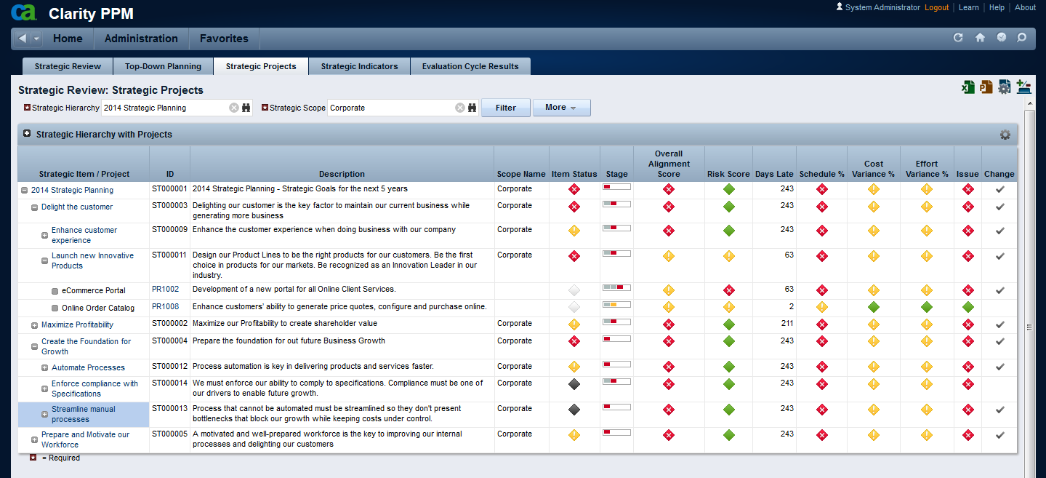
Projects Impact on Strategies (Health-Check)
Strategic Hierarchy with Projects
Strategic Projects “Health-Check” with Roll-up KPIs

Slide 25
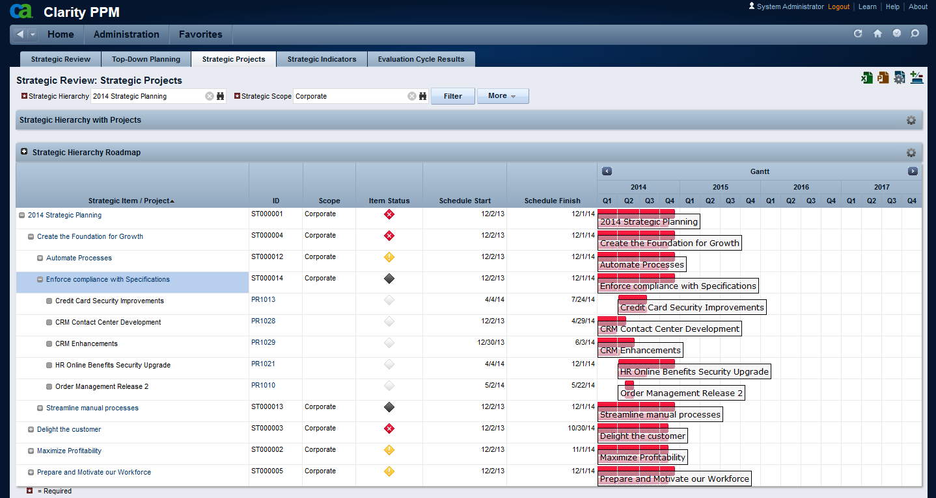
Strategic Results delivery Roadmap
Strategic Hierarchy with Projects
Strategic Results delivery Roadmap

Slide 26
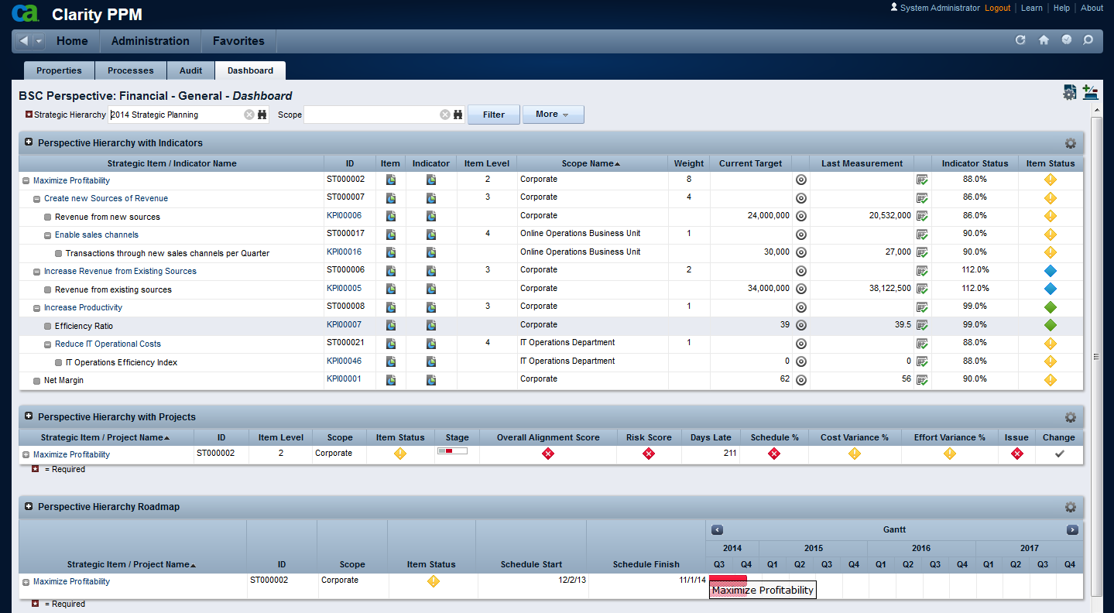
Visão por Perspectiva do Balanced Scorecard
Balanced Scorecard Perspective Dashboard
Perspective Hierarchy with Indicators
Hierarchy with Strategic Projects Impacts
Results Delivery Roadmap
Go Back

Slide 27
Investment Evaluation for Selection

Slide 28
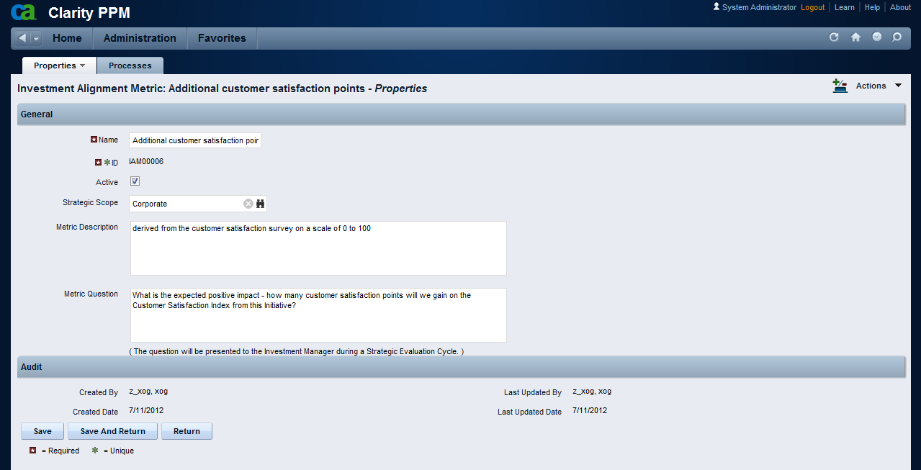
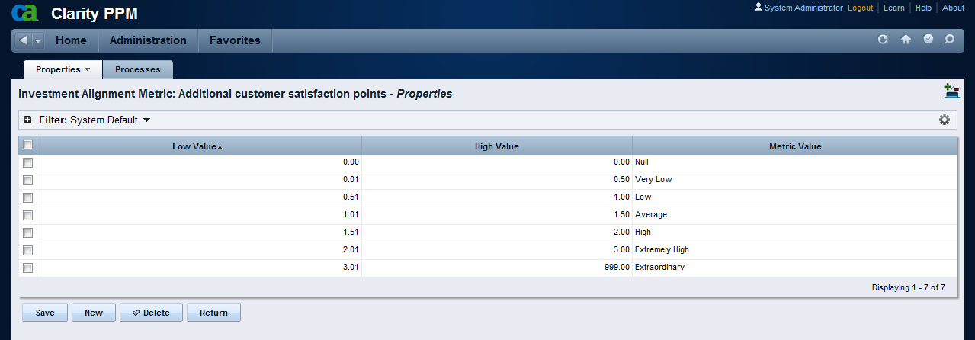
Investments Evaluation for Prioritization and Selection
Investment Alignment Metric
Alignment Metrics are used to help Evaluate Ideas, Projects and Programs as to their objective (rather than subjective) Strategic Contribution
Normalized Scale: quantitative metrics (days, amounts, products, hours, etc.) are normalized in a qualitative scale from 0 (null) to 100 (extraordinary), allowing for posterior comparison – helping eliminate subjectivity from the evaluation process

Slide 29
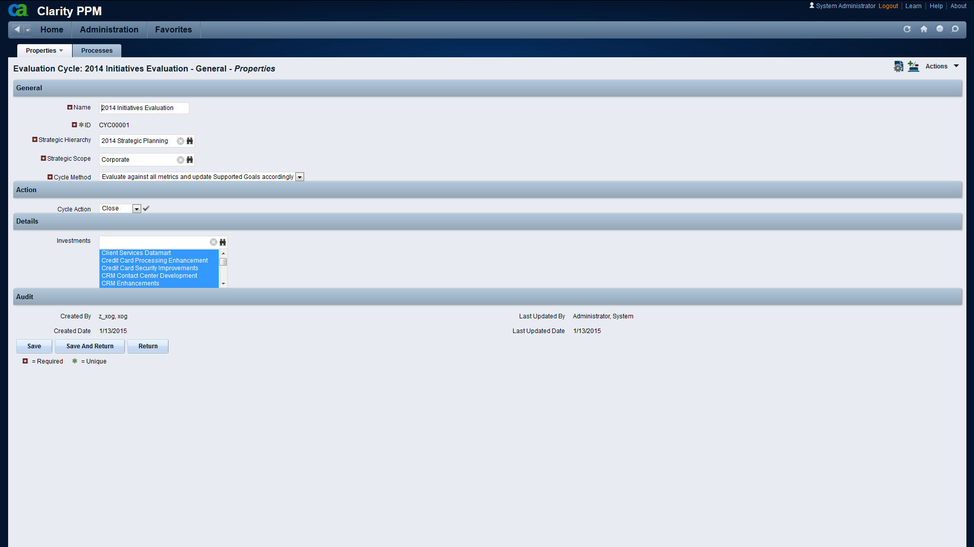
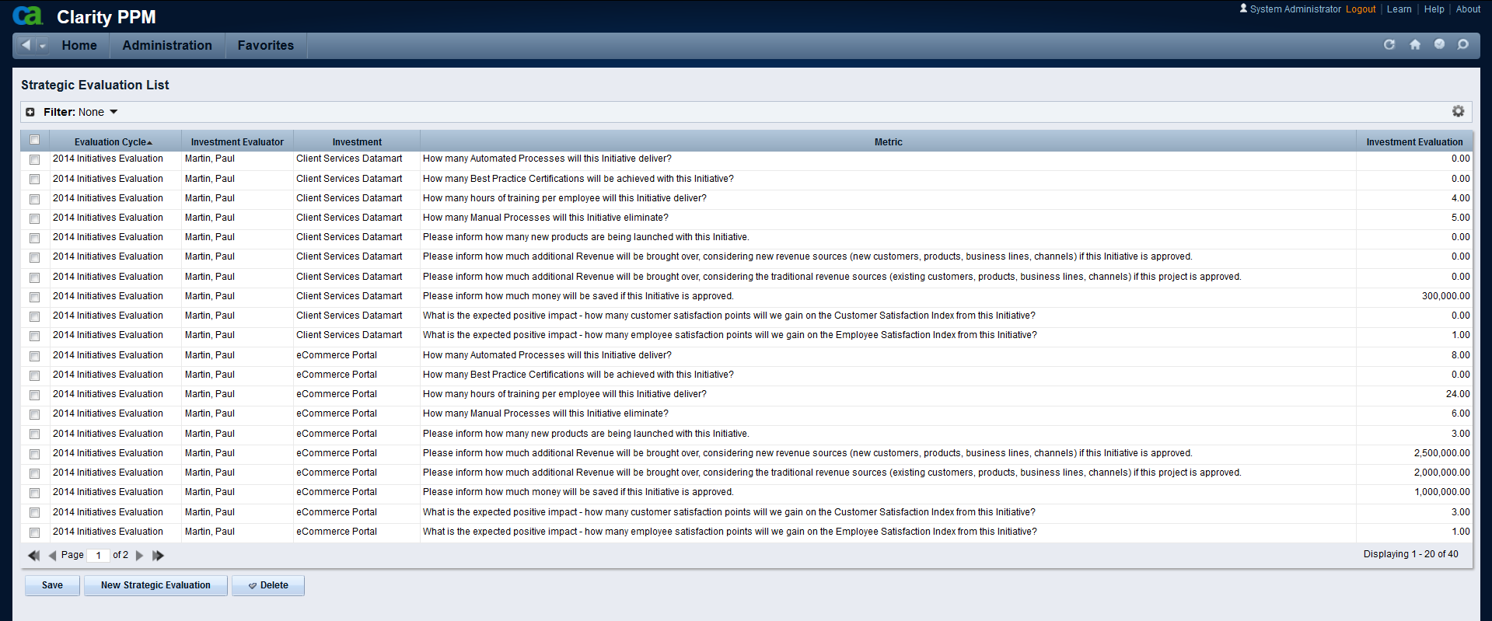
Investments Evaluation for Prioritization and Selection
Evaluation Cycle
The Investments supporting Strategic Goals can manually set by the user or determined automatically inferred by the system – based on how the questionnaires are answered
The investment “owner” will get a questionnaire and needs to inform how much his Project will contribute to increasing each metric.
Which investments (Ideas, Projects, Programs, etc.) are we evaluating at this time?

Slide 30
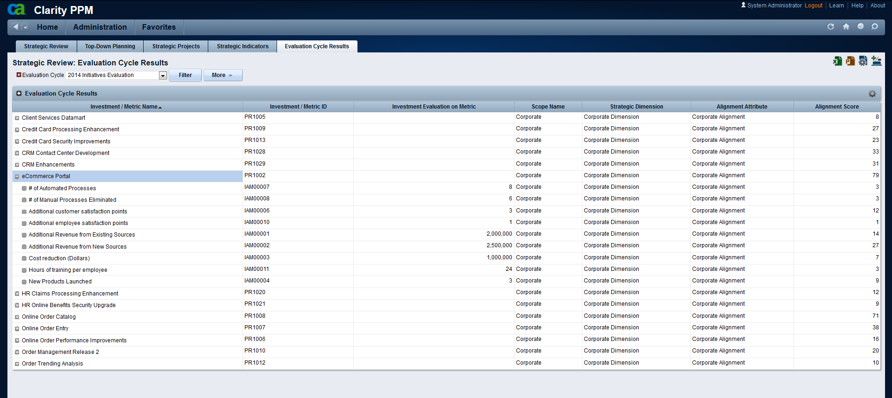
Investments Evaluation for Prioritization and Selection
Evaluation Cycle Results
Investments (Ideas, Projects, Programs) that were Evaluated on this Cycle
Strategic Alignment Score that has been calculated for each Investment
The Investment can be evaluated multiple times, in multiple dimensions, to generate a “composed” score, i.e. Corporate Alignment, Business Unit Alignment and Department Alignment
Drill-down to how the score was calculated – the contribution to each metric

Slide 31
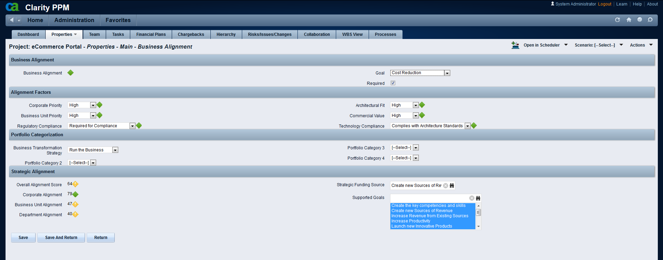
Investments Evaluation for Prioritization and Selection
Strategic Evaluation Results
This is the Strategic Score obtained by a project after the Evaluation Cycles
Multidimensional Evaluation: Corporate Strategy, BU Strategy, Department Strategy, completely configurable
One of the Strategic Goals will be the Primary source of Funding
These are the Strategic Goals supported by this project. They can be automatically inferred or manually pre-defined.

Slide 32
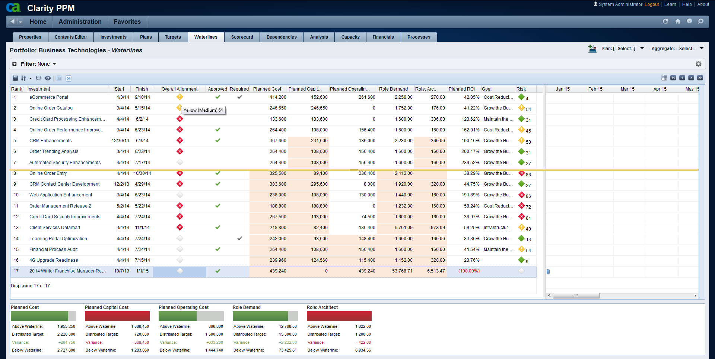
Investments Evaluation for Prioritization and Selection
The Score can be used in Portfolio Waterlines for Decision-making
The Strategic Alignment Score that was calculated is used to prioritize the most important investments (Ideas, Projects, Programs) for the Organization’s strategies – to help you select.
Go Back

Slide 33
Top-Down Planning

Slide 34
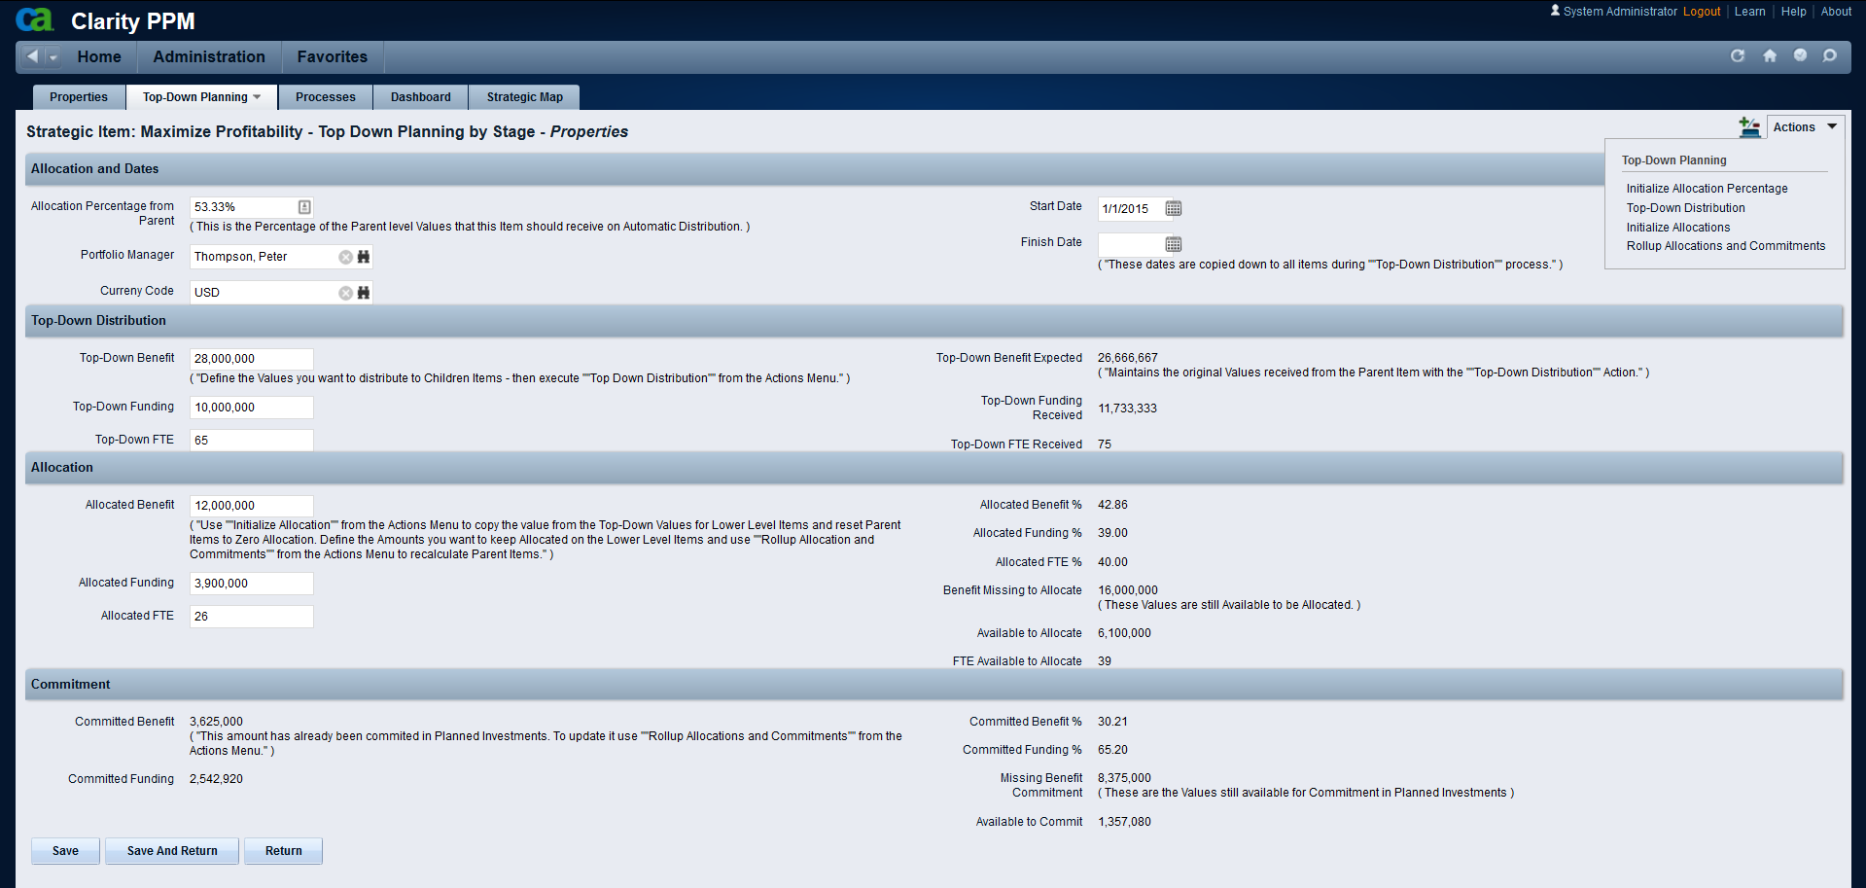
Top-Down Planning
Define your Amounts and use the Automated Actions
Top-Down Distribution
Allocated Amounts
Actions to help you speed-up your Top-Down amounts distribution and Bottom-Up amounts roll-up
Committed Amounts
Notes:
Top-Down Distribution are the values you cascade from your top levels.
Allocations are the values you actually define as your constraints for portfolios.
Commitments are driven from approved Investments and represent what has actually been planned.

Slide 35
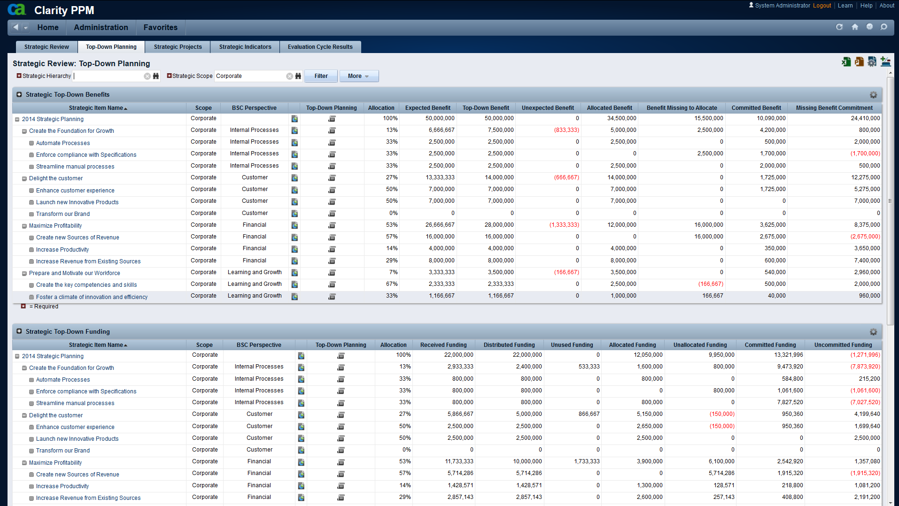
Top-Down Planning
Hierarchical View – Funds and Benefits
Top-Down Distribution And Balance
Allocated Amounts And Balance
Commitments
And Balance
Expected Benefits
Funding

Slide 36
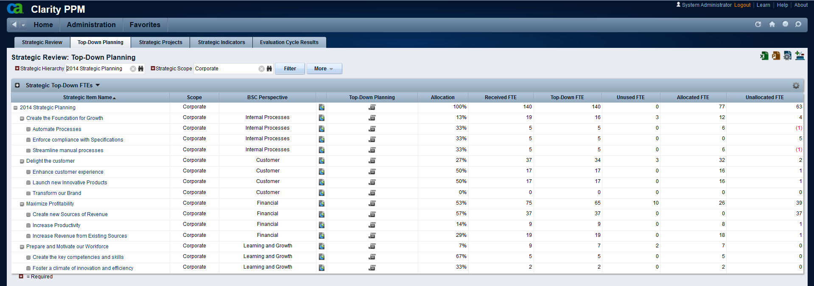
Top-Down Planning
Hierarchical View –Headcount Plan (FTEs)
Top-Down Distribution and Balance
Allocated values and Balance
Headcount Plan (FTEs)

Slide 37
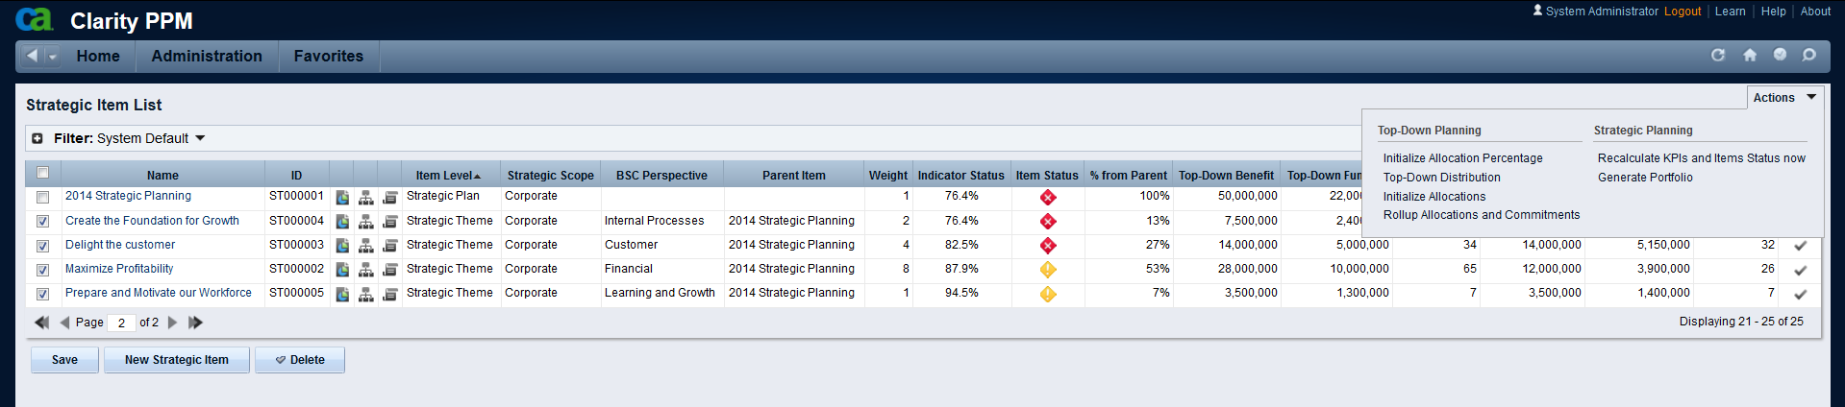
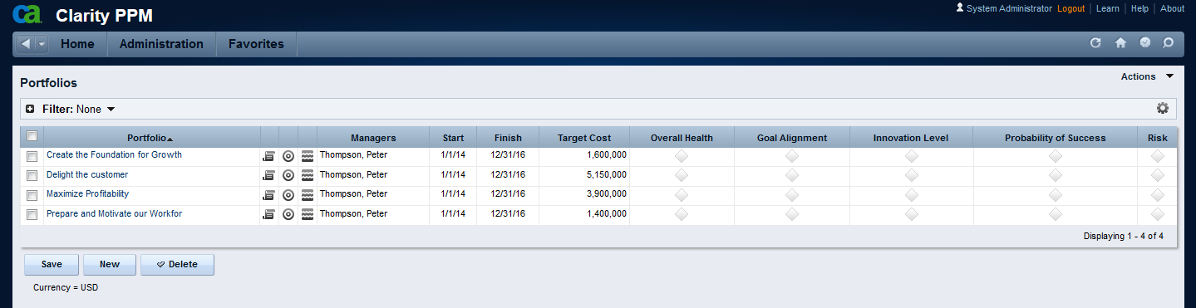
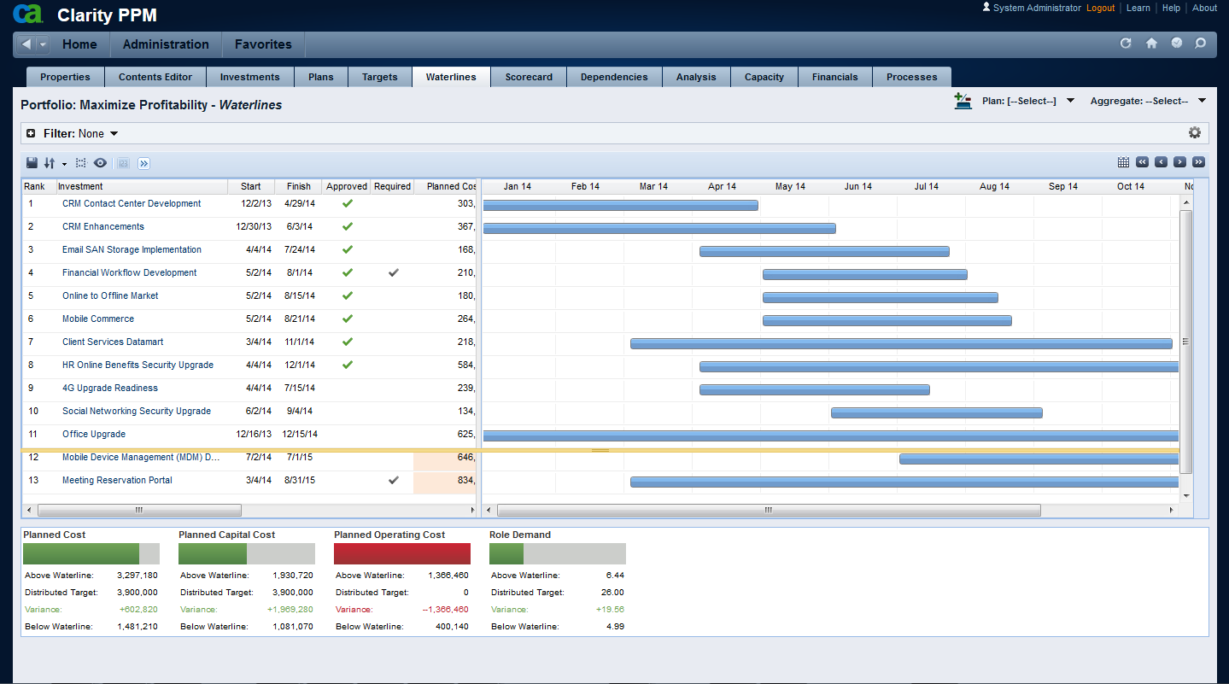
Top-Down Planning
Automatic Portfolio Generation
Automatic Portfolio Generation
Go Back

Slide 38
Alexandre Assis
Sr Director, Presales
Alexandre.Assis@ca.com
@cainc
slideshare.net/CAinc
linkedin.com/company/ca-technologies
ca.com

